Slide 2
A CAREER PLATFORM WHICH PROVIDES SUPPORT TO STUDENTS WHEN…
Company profiles
Job videos
Career events
Job offers on the JobTeaser network
Job offers exclusive to their university
An Advice module
Videos by recruitment specialists
LOOKING FOR AN INTERNSHIP, PLACEMENT OR JOB
BUILDING THEIR CAREER PATH
PREPARING FOR INTERVIEWS

Slide 3
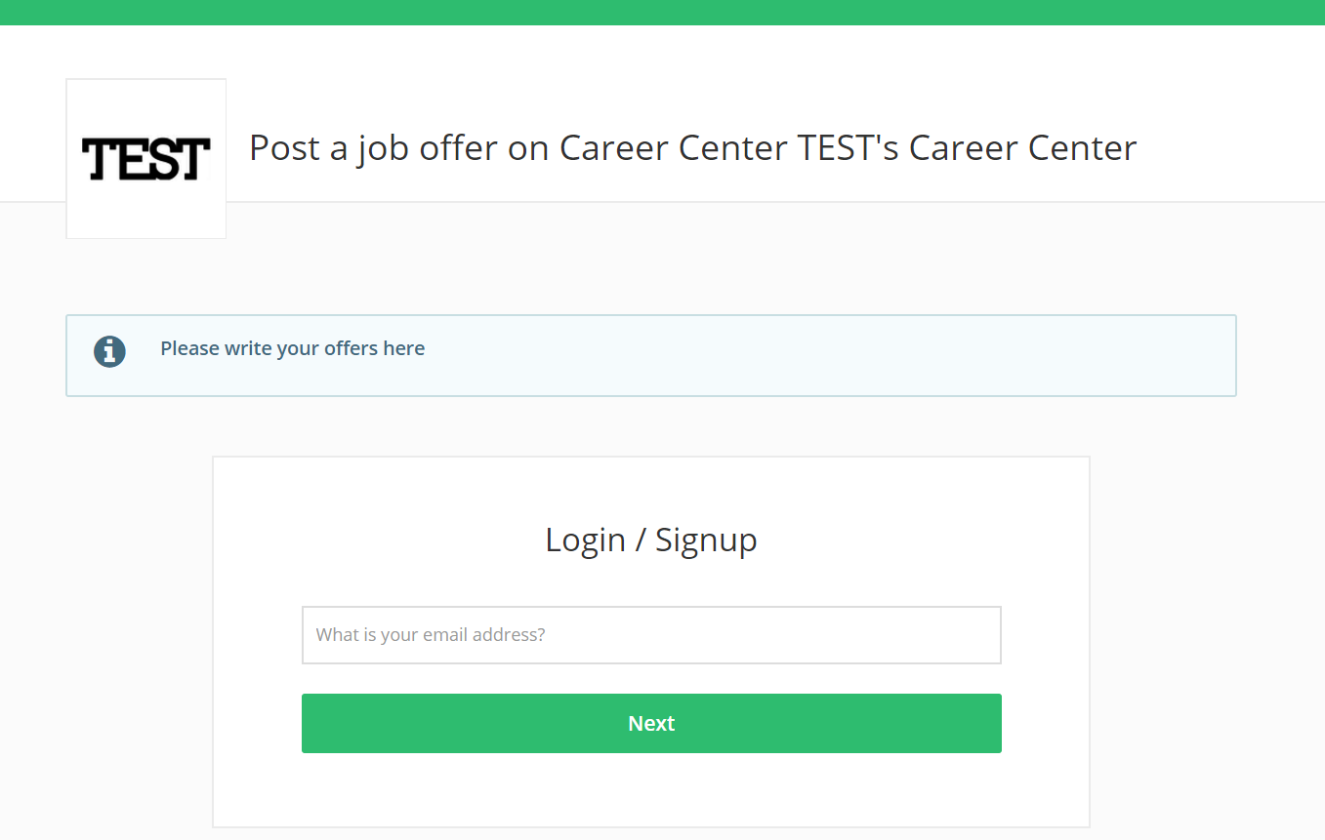
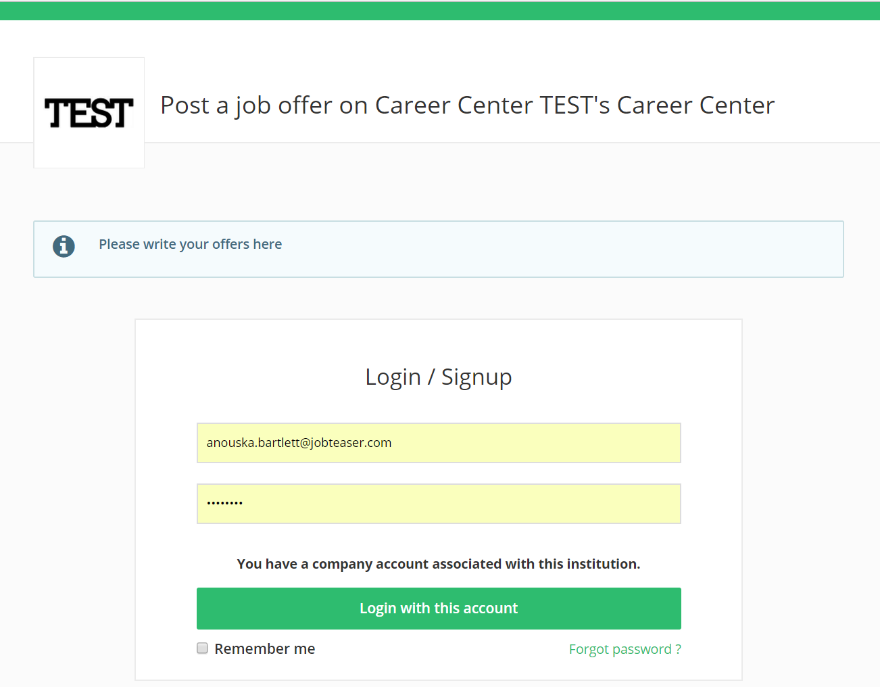
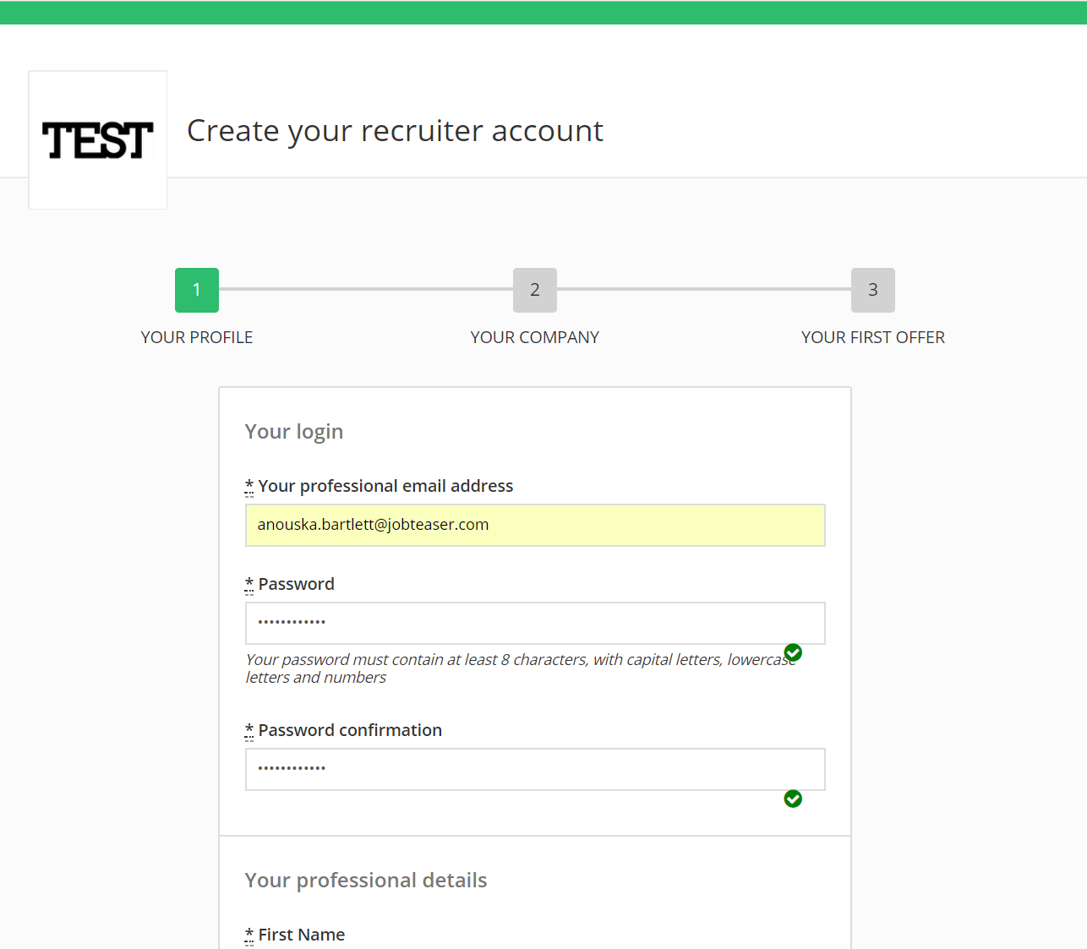
Follow the link : https://ju.jobteaser.com/en/recruiter_account/job_offers
Click on the link to the form.
If you already have an account, enter your password to access your account.
OR
If you haven't got an account, fill in the required details.

Slide 4
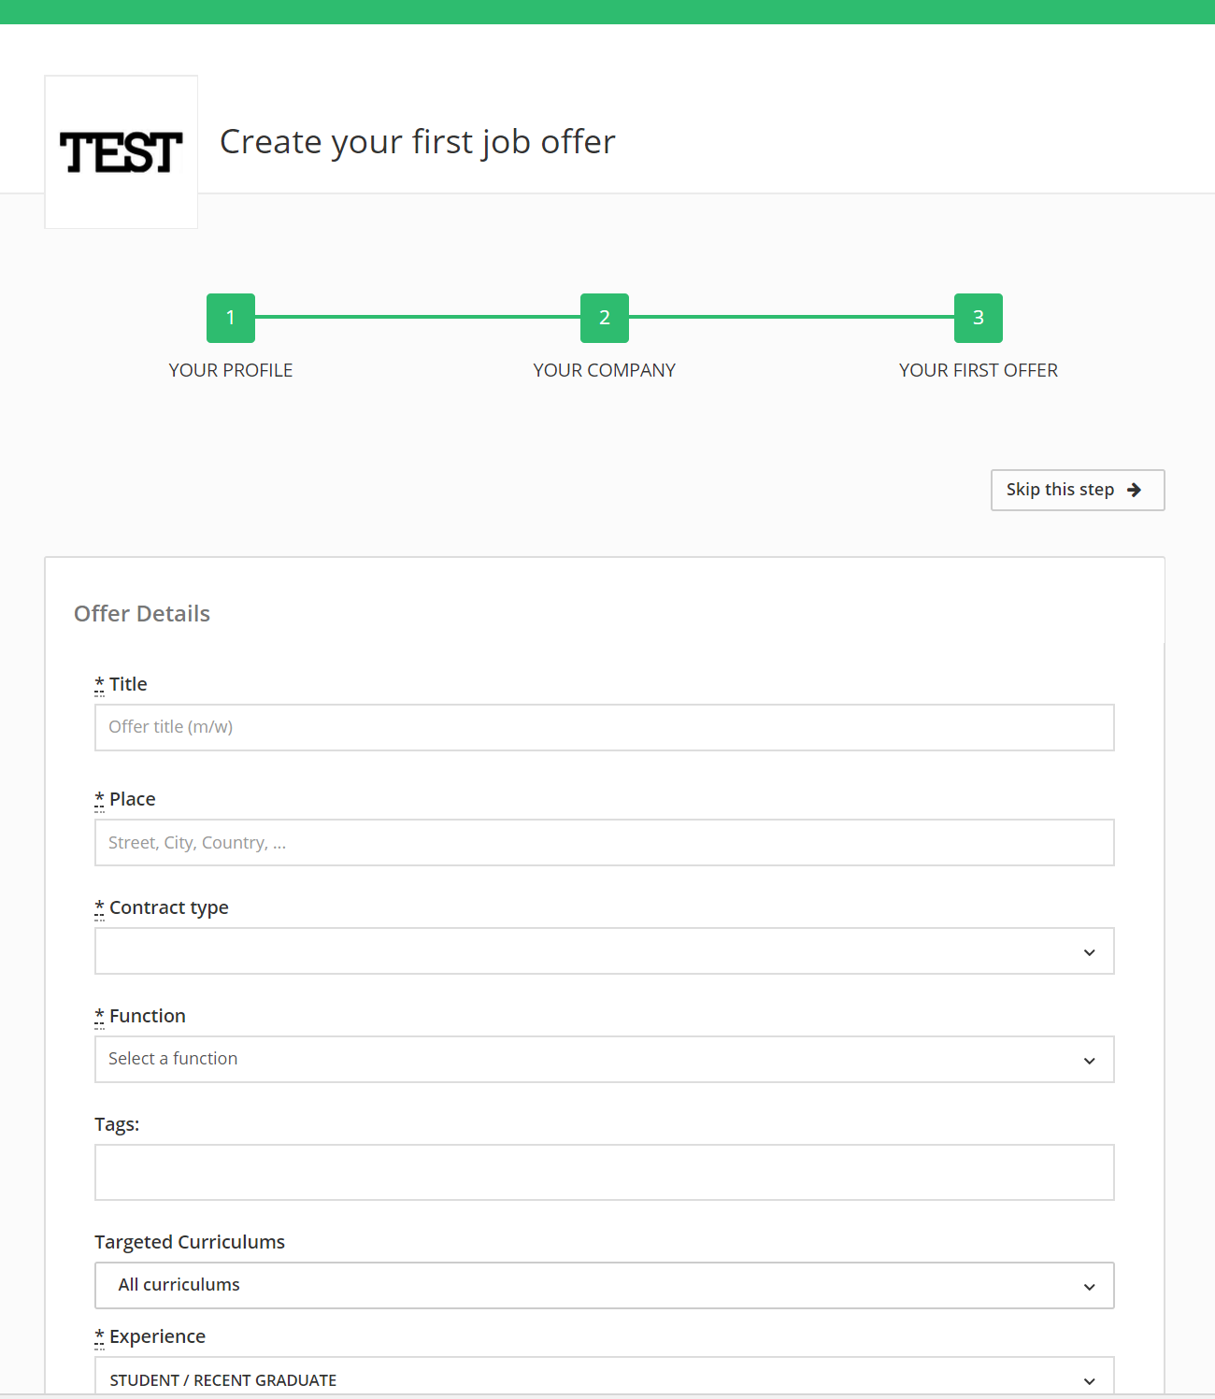
If you haven't got an account, we'll guide you through the process of creating your first job offer.
If you already have an account, add your job offers directly via the back office.
OR
The school will validate or reject the job offer. You will receive a confirmation email.

Slide 5
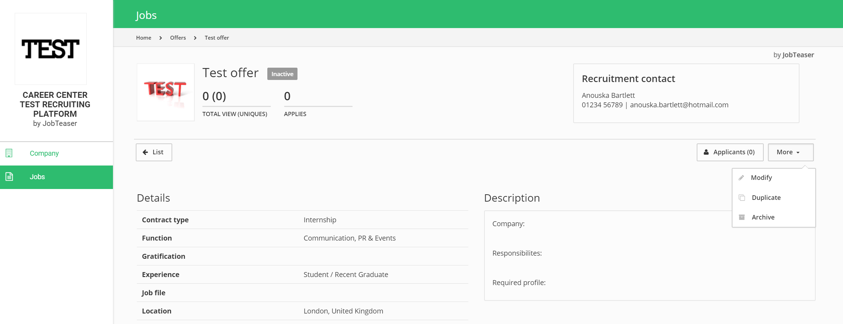
You can see the applications and the number of unique views for each offer.
You can archive your job offers. You can post your job offers again by clicking on "Archived" and then "Post again".

